Slide 1

“Promoting Independent Living”
A presentation by
Leitrim Association of People With Disabilities

Slide 2
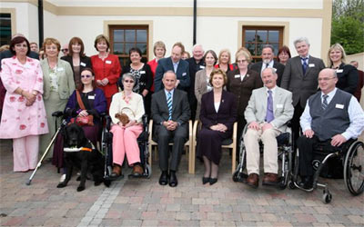
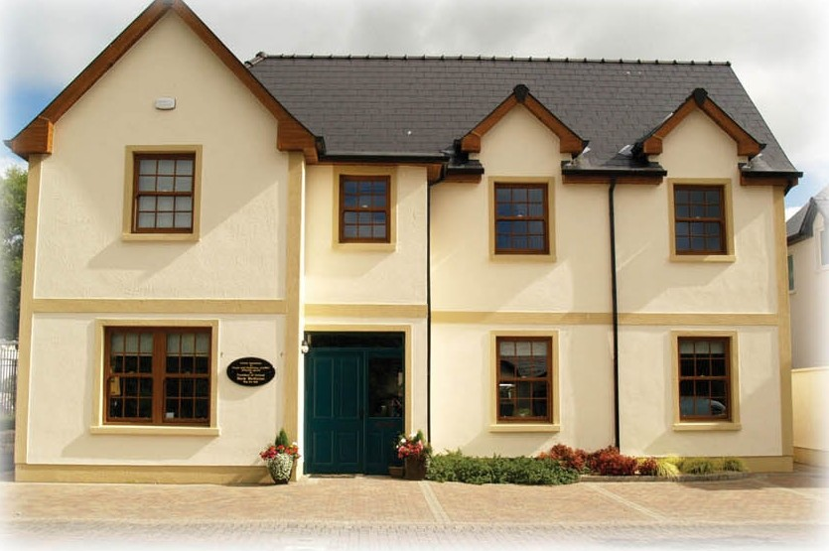
About Us
The Directors and staff with President Mary and Dr Martin Mcaleese at the opening of the ActionAbility Centre, May 2008
We are a CENTRE FOR INDEPENDENT LIVING, run BY and FOR people with disabilities

Slide 3
About Our Activities
We co-ordinate a Personal Assistant (PA) service for people with disabilities (Leaders)
We run member sub-groups e.g. Men’s Group, Women Independently Living in Leitrim (WILL), Writers’ Group; and training courses e.g. Sign Language, Digital Photography, Art Classes
We have our own Mini-bus which assists our members getting to appointments, meetings and events
We have excellent training facilities, and have hosted physiotherapy clinics, HSE meetings, informational meetings on rights and entitlements, health etc.
We are launching C.A.L.L.; the Campaign for Accessible Living in Leitrim… watch this space!

Slide 4

Experience & Outlook
We have been operating since 1995, and have always been a member-led organisation
We are listening to our members to improve and expand our activities
We have good working relationships with other disability organisations, such as the IWA, PwDI, NCBI; and continue to share resources and expertise
Independent Living is about realising the Human Rights of all people with disabilities: in hard times, it is even more important to stand together and fight for our basic needs and wildest dreams

Slide 5
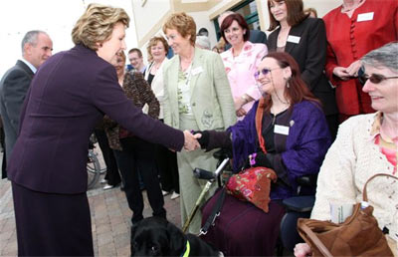
Contact Details
Leitrim Association of People With Disabilities (LAPWD)
ActionAbility Centre,
Station Road,
Mohill,
Co. Leitrim
www.lapwd.com
info@lapwd.com
Secretary: Rosaleen Kielty
Tel: 071 9651000
Fax: 071 9651006
email: rosaleen@lapwd.com
Chairperson: Isolde Carmody
Tel: 071 9621936
Text: 086 8820445
email: isoldecarmody@gmail.com

